Slide 1
HISTORIC YEAR 2019-2023 AND FORECAST TO 2032
GERMAN EXTRACT-BASED MAGISTRALS MARKET
By Product Type: Herbal Extracts, Essential Oils, Phytochemicals, Spices, Others By Extract Source: Plant, Animal By Application: Pharmaceuticals, Cosmetics & Personal Care, Dietary Supplements By End User: Pharmaceutical & Nutraceutical Companies, Hospitals & Clinics, Research & Academia, Food & Beverage Industry, Others By Distribution Channel: Online (Direct Sales, B2B, Distributors), Offline (Direct Sales, B2B, Distributors) By Region: North America, Europe, Asia-Pacific, Latin America, Middle East & Africa

Slide 2
MARKET SEGMENTATION
GERMAN EXTRACT-BASED MAGISTRALS MARKET (USD MILLION)
YEARS CONSIDERED :
Historical Year - 2019-2023 | Base Year - 2024 | Forecast Year - 2025-2032
BY PRODUCT TYPE
BY EXTRACT SOURCE
BY APPLICATION
BY END USER
BY DISTRIBUTION CHANNEL
Herbal Extracts
Essential Oils
Phytochemicals
Spices
Others
Plant
Animal
Pharmaceuticals
Cosmetics & Personal Care
Dietary Supplements
Pharmaceutical & Nutraceutical Companies
Hospitals & Clinics
Research & Academia
Food & Beverage Industry
Others
Online
Offline

Slide 3

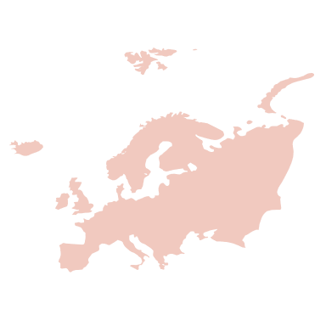




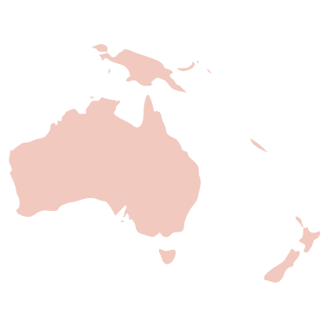

MARKET TAXONOMY
GERMAN EXTRACT-BASED MAGISTRALS MARKET (USD MILLION)
YEARS CONSIDERED :
Historical Year - 2019-2023 | Base Year - 2024 | Forecast Year - 2025-2032
NORTH AMERICA
EUROPE
ASIA PACIFIC
LATIN AMERICA
MIDDLE EAST & AFRICA
Mexico
GCC Countries
United Kingdom
China
Brazil
Canada
Germany
France
Japan
Spain
South Korea
United States
Italy
India
South Africa
United Kingdom
Germany
France
Spain
GCC Countries
South Africa
Rest of MEA
Italy
Rest of Europe
China
Japan
India
Brazil
Mexico
Rest of LATAM
United States
Canada
South Korea
Rest of APAC

Slide 4
TABLE OF CONTENTS-
GERMAN EXTRACT-BASED MAGISTRALS MARKET-
HISTORIC YEAR 2019-2023 FORECAST TO 2032

Slide 5

TABLE OF CONTENTS
1. Introduction | 4.5. Demand Side Trends
1.1. Objectives of the Study | 4.6. Porter's Analysis & Impact
1.2. Market Definition & Scope | 4.6.1. Competitive Rivalry
2. Research Methodology | 4.6.2. Threat of substitutes
2.1. Research Process | 4.6.3. Bargaining power of buyers
2.2. Secondary & Primary Data Methods | 4.6.4. Threat of new entrants
2.3. Market Size Estimation Methods | 4.6.5. Bargaining power of suppliers
2.4. Market Assumptions & Limitations | 5. Key Market Insights
3. Executive Summary | 5.1. Key Success Factors
3.1. Global Market Outlook | 5.2. Market Impacting Factors
3.2. Key Market Highlights | 5.3. Top Investment Pockets
3.3. Segmental Overview | 5.4. Market Attractiveness Index, 2024
4. Market Dynamics & Outlook | 5.5. Market Ecosystem
4.1. Macro-Economic Indicators​ | 5.6. PESTEL Analysis
4.2. Drivers & Opportunities | 5.7. Pricing Analysis
4.3. Restraints & Challenges | 5.8. Regulatory Landscape
4.4. Supply Side Trends | 5.9. Case Studies

Slide 6
TABLE OF CONTENTS
5.10. Regulatory Analysis | 9.2. Hospitals & Clinics
5.11. Value Chain Analysis | 9.3. Research & Academia
6. German Extract-Based Magistrals Market Size by Product Type (2019-2032) | 9.4. Food & Beverage Industry
6.1. Herbal Extracts | 9.5. Others
6.2. Essential Oils | 10. German Extract-Based Magistrals Market Size by Distribution Channel (2019-2032)
6.3. Phytochemicals | 10.1. Online
6.4. Spices | 10.1.1. Direct Sales
6.5. Others | 10.1.2. B2B
7. German Extract-Based Magistrals Market Size by Extract Source (2019-2032) | 10.1.3. Distributors
7.1. Plant | 10.2. Offline
7.2. Animal | 10.2.1. Direct Sales
8. German Extract-Based Magistrals Market Size by Application (2019-2032) | 10.2.2. B2B
8.1. Pharmaceuticals | 10.2.3. Distributors
8.2. Cosmetics & Personal Care | 11. Global German Extract-Based Magistrals Market Size by Region (2019-2032)
8.3. Dietary Supplements | 11.1. North America (By Product Type, By Extract Source, By Application, By End User, By Distribution Channel)
9. German Extract-Based Magistrals Market Size by End User (2019-2032) | 11.1.1. US
9.1. Pharmaceutical & Nutraceutical Companies | 11.1.2. Canada

Slide 7
TABLE OF CONTENTS
11.2. Europe (By Product Type, By Extract Source, By Application, By End User, By Distribution Channel) | 11.5. Middle East & Africa (By Product Type, By Extract Source, By Application, By End User, By Distribution Channel)
11.2.1. UK | 11.5.1. GCC Countries
11.2.2. Germany | 11.5.2. South Africa
11.2.3. Spain | 11.5.3. Rest of Middle East & Africa
11.2.4. France | 12. Competitive Landscape
11.2.5. Italy | 12.1. Competitive Dashboard
11.2.6. Rest of Europe | 12.2. Market Positioning of Key Players, 2024
11.3. Asia-Pacific (By Product Type, By Extract Source, By Application, By End User, By Distribution Channel) | 12.3. Strategies Adopted by Key Market Players
11.3.1. China | 12.4. Recent Developments in the Market
11.3.2. India | 12.5. Company Market Share Analysis, 2024
11.3.3. Japan | 13. Key Company Profiles
11.3.4. South Korea | 13.1. Anklam Extrakt GmbH
11.3.5. Rest of Asia Pacific | 13.1.1. Company Overview
11.4. Latin America (By Product Type, By Extract Source, By Application, By End User, By Distribution Channel) | 13.1.2. Product Portfolio Overview
11.4.1. Brazil | 13.1.3. Financial Overview
11.4.2. Mexico | 13.1.4. Key Developments
11.4.3. Rest of Latin America | The following companies are listed for indicative purposes only. Similar information will be provided for each, with detailed financial data available exclusively for publicly listed companies.

Slide 8
TABLE OF CONTENTS
13.2. Hawlik bioimport gmbh | 13.19. Europlant Group
13.3. Bösch Boden Spies GmbH & Co. KG | 13.20. Kräuter Mix
13.4. Gehrlicher Pharma­­zeutische Ex­trakte GmbH | Note : The list of companies mentioned are for indication purpose and are subject to change over the due course of the research
13.5. HERBAL CREATIONS | 14. Conclusion & Recommendation
13.6. WEECO Pharma GmbH
13.7. Dr. Willmar Schwabe GmbH & Co. KG
13.8. Dr. Spiller GmbH
13.9. KD Pharma
13.10. Kerry Group
13.11. Archer Daniels Midland
13.12. Biomed Ingredients GmbH
13.13. MartinBauer Group
13.14. Finzelberg GmbH & Co. KG
13.15. Josh Naturals GmbH
13.16. Destilla GmbH
13.17. Möller Pharma GmbH
13.18. Aromaplant GmbH

Slide 9
RESEARCH METHODOLOGY
Research Process
Secondary & Primary Data Methods
Market Size Estimation Methods
Market Assumptions & Limitations
GERMAN EXTRACT-BASED MAGISTRALS MARKET -
HISTORIC YEAR 2019-2023 FORECAST TO 2032

Slide 10
RESEARCH METHODOLOGY
Research Objective
The process begins with clearly defining the research objective, which serves as the foundation for the study. This step identifies the specific goals, questions, or problems the research aims to address.
Research Objective
Secondary Research
Secondary research involves collecting existing data from credible sources to build a comprehensive baseline. This stage gathers relevant insights to contextualize the study and identify data gaps.
Data Modelling
Secondary Research
Data Analysis
Primary Research
Primary Research
Primary research directly gathers first-hand data to validate, complement, or update insights obtained during secondary research. It involves interacting with industry stakeholders to provide real-time insights and market perspectives.
Data Modelling
This step involves using data modeling techniques to forecast future trends and market behavior. Predictive modeling ensures informed decision-making by aligning results with economic, industry, and population metrics.
Data Analysis
Data collected through secondary and primary research is rigorously analyzed to uncover patterns, trends, and actionable insights. This step ensures that findings are relevant, consistent, and aligned with the research objectives
Data Reporting
The findings and insights are compiled into a detailed, well-structured report that aligns with the client's needs and objectives. The report provides actionable recommendations and data-driven conclusions.
Data Reporting

Slide 11

SECONDARY RESEARCH
The purpose of secondary research is to build a solid foundation for understanding the target market by leveraging existing data, reports, and publications. This step is essential to gaining an initial perspective on the market size, trends, competitive dynamics, challenges, and opportunities. Secondary research helps map out broad market insights that can guide further exploration and refinement of the research focus.
Analyst's Role:
Source information from industry reports, government data, trade publications, and online repositories.
Map out the competitive landscape, market challenges, and emerging opportunities.
Highlight data gaps and refine the focus for primary research.
Data Sources
Association and Organization | Research Paper and Journal | Competition Data | Paid Databases | SkyQuest Internal Database
Bundesinstitut für Arzneimittel und Medizinprodukte (BfArM) | Phytomedicine | Annual Report | Factiva
Bundesapothekerkammer (BAK) | Journal of Ethnopharmacology | Investor Presentation | Bloomberg
ABDA – Bundesvereinigung Deutscher Apothekerverbände e.V. | Planta Medica | SEC Filling/ 10K Sizes | Hoovers
Deutsche Gesellschaft für Phytotherapie (DGfP) | Die Pharmazie | Company Website | Morningstar
Bundesinstitut für Risikobewertung (BfR) | International Journal of Pharmaceutics | Trade Data | Seeking Alpha

Slide 12
PRIMARY RESEARCH
The purpose of executing primary research is to gather firsthand insights that validate and complement the data gathered during secondary research. By directly engaging with market participants, primary research ensures that the findings are grounded in real-world market dynamics. This step provides fresh, up-to-date, and specific information that is essential to gain a more nuanced understanding of the market, uncovering insights that secondary sources may not capture.
Analyst's Role:
Develop interview guides and surveys tailored to the study's objectives
Engage with key industry stakeholders, such as business leaders, end-users, and experts.
Capture a blend of qualitative and quantitative data, ensuring diversity in perspectives.
Break up of Primary Interviews with Industry Experts
BY COMPANY
BY DESIGNATION
BY REGION

Slide 13
EXECUTIVE SUMMARY
GERMAN EXTRACT-BASED MAGISTRALS MARKET-
HISTORIC YEAR 2019-2023 FORECAST TO 2032

Slide 14
EXECUTIVE SUMMARY
MARKET OUTLOOK
FIGURE 01. GERMAN EXTRACT-BASED MAGISTRALS MARKET SIZE, (USD MILLION)
The German Extract-Based Magistrals Market is valued at USD 11 Million in 2024, and is expected to reach USD 11 Million by 2032. The market shows a steady CAGR of 11% from 2025 to 2032. Rising demand for personalized phytopharmaceuticals, stricter GMP-compliant magistral manufacturing, and regulatory support for herbal extracts drive Germany's extract-based magistrals market; innovation by specialty pharmacies and contract manufacturers, consolidation among key players, digital prescribing platforms, and sustainability-focused sourcing signal robust growth, with expanded therapeutic adoption and export potential ahead, market diversification.
Key Market Enablers
11
Regulatory clarity and quality standards: Consistent legal frameworks, explicit magistral compounding guidance, pharmacopoeial monographs and enforceable Good Manufacturing Practice for pharmacies enable market growth by reducing legal uncertainty, ensuring batch quality, and facilitating supplier investment, while harmonized testing standards build clinician and payer confidence across Germany. Prompting broader adoption nationwide. Clinical adoption, reimbursement and patient demand: Growing clinician familiarity, robust real‑world evidence and education increase prescribing of extract-based magistrals. Concurrent reimbursement pathways, pharmacy compensation clarity and patient advocacy reduce cost barriers and stimulate demand. Coordinated payer engagement and outcomes data collection accelerate coverage decisions, improving long-term market sustainability and access.
11

Slide 15


EXECUTIVE SUMMARY
TOP-10 COUNTRY ASSESSMENT, 2024 (%)
GERMAN EXTRACT-BASED MAGISTRALS MARKET
SEGMENTAL OVERVIEW, 2024 (%)
GERMAN EXTRACT-BASED MAGISTRALS MARKET
USD 11 MILLION

Slide 16
MARKET DYNAMICS & OUTLOOK
Macro-Economic Indicators
Drivers & Opportunities
Restraints & Challenges
Supply Side Trends
Demand Side Trends
Porters Analysis & Impact
Threat of New Entrants
Bargaining Power of Suppliers
Bargaining Power of Buyers
Threat of Substitute
Intensity of Competitive Rivalry
GERMAN EXTRACT-BASED MAGISTRALS MARKET -
HISTORIC YEAR 2019-2023 FORECAST TO 2032

Slide 17


MARKET DYNAMICS & OUTLOOK
SUPPLY SIDE TRENDS
DEMAND SIDE TRENDS

Slide 18
MARKET DYNAMICS & OUTLOOK : MARKET DRIVERS & OPPORTUNITIES (1/X)
Regulatory evolution in Germany is a primary driver for extract-based magistrals, reshaping pharmacy compounding practices and clinical use. German authorities such as BfArM and the Paul Ehrlich Institute have clarified guidance that influences formulation standards and safety expectations. Real-world examples include community and hospital pharmacies adapting protocols for cannabis extracts and botanical tinctures to meet pharmacopoeial quality. These regulatory clarifications foster professional confidence among pharmacists and prescribers, enabling broader adoption of personalized extract magistrals within established healthcare pathways and practice. Clinical interest and accumulating evidence foster physician and pharmacist acceptance of extract magistrals, propelled by studies from German universities and specialty clinics. Professional organizations, including pharmacy associations and medical societies, issue guidance framing safe, evidence informed compounding practices. Examples of collaboration between university hospitals and community pharmacies illustrate refined approaches for botanical and cannabis preparations, improving tolerability and adherence in clinical settings. Such clinical validation motivates prescribers to integrate magistral extracts as individualized therapeutic tools within coordinated patient care pathways. German pharmacy tradition of magistral compounding underpins personalized extract formulations, meeting unique patient needs across outpatient and hospital contexts. Community pharmacists leverage compounding skills to tailor dosages, routes, and excipient choices for vulnerable groups such as pediatric and palliative patients. Practice includes individualized cannabis oil titration and bespoke herbal tinctures prepared in licensed pharmacies according to prescriber directions. This cultivated expertise positions pharmacists as integral partners in therapeutic customization, strengthening trust among clinicians and patients seeking tailored extract solutions today. Supply chain integrity and stringent quality standards drive confidence in extract-based magistrals, emphasizing traceability from botanical cultivation to finished preparation. German compounding pharmacies and contract manufacturers implement good manufacturing practices and reference pharmacopoeial monographs in the German Pharmacopoeia to ensure consistent extract profiles. Examples include authenticated supply chains for medicinal cannabis and validated extraction methods adopted by specialty suppliers. Emphasis on raw material provenance, analytical testing, and stability practices reassures clinicians and patients about safety and predictable therapeutic outcomes overall.
Evolving regulatory and clinical acceptance of extract magistrals
*Please note that the drivers and opportunities mentioned here are only for representation purpose; a comprehensive analysis will be provided in the final report.

Slide 19
MARKET DYNAMICS & OUTLOOK : MARKET DRIVERS & OPPORTUNITIES (2/X)
German magistral producers increasingly form direct partnerships with regional botanical growers to secure consistent, traceable raw materials for extract preparations. Examples include German licensed cannabis cultivators working with pharmacies and herb farms in Bavaria and Mecklenburg, and research collaborations with institutions such as the University of Hohenheim to select stable cultivars. This localized model aligns with regulatory oversight from national bodies like the BfArM and the Deutsches Arzneibuch, reducing reliance on distant suppliers and improving quality control for compounded magistrals. Traceability from seed to finished extract is becoming central to magistral credibility, with pharmacies and growers implementing rigorous documentation and quality frameworks. German apothekerkammer and Bundesapothekerkammer guidance supports batch records and supplier audits, while some botanical suppliers adopt organic certification and pharmaceutical good manufacturing practice principles to meet compounding expectations. Real-world pilots by pharmacies integrate digital traceability systems linking harvest data to compounding logs, enabling transparent provenance statements for physicians and patients who request bespoke extract-based magistrals in clinical practice. Sustainability credentials increasingly differentiate magistral extracts, with German patients and prescribers valuing environmentally responsible sourcing and transparent agricultural practices. Growers seek certifications such as Bioland or Demeter to signal organic stewardship, while pharmacies highlight regional sourcing in patient consultations. Supply chain adaptations include rotational cropping, reduced agrochemical inputs, and water management measures driven by agronomy research centers. These sustainability steps not only respond to consumer expectations but also mitigate supply volatility and support availability of botanicals for magistral compounding practices. Advances in extraction and formulation technologies expand the therapeutic potential of magistral extracts, enabling pharmacies to offer tailored delivery systems and improved bioavailability. German CDMOs and research institutes like the Fraunhofer network work on scalable supercritical CO2 and green solvent extraction methods that preserve phytochemical profiles. Community pharmacies collaborate with clinical teams to formulate innovative vehicles such as mucosal sprays and suppositories for bespoke indications, illustrating how technological transfer from labs to apothecaries enhances personalized extract-based compounding in clinical practice.
Local cultivation partnerships bolstering German magistral supply resilience
*Please note that the drivers and opportunities mentioned here are only for representation purpose; a comprehensive analysis will be provided in the final report.

Slide 20
MARKET DYNAMICS & OUTLOOK : MARKET RESTRAINTS & CHALLENGES [1/X]
Regulatory fragmentation across federal and state authorities raises compliance burdens for pharmacies producing extract-based magistrals. In Germany, the Arzneimittelgesetz, the Deutsches Arzneibuch and guidance from the Bundesinstitut für Arzneimittel und Medizinprodukte establish overlapping requirements for formulation, documentation and pharmacopoeial standards. Practical examples include differing state pharmacy inspectorate expectations for stability testing and labeling, forcing community and hospital pharmacies to implement diverse quality systems. This complexity diverts pharmacist time toward paperwork and external audits, reducing capacity for individualized compounding patient services. Ensuring consistent extract quality poses technical hurdles for magistral formulations because botanical raw materials exhibit intrinsic variability and potential contaminants. German pharmacies must validate analytical methods such as high performance liquid chromatography and mass spectrometry to control potency and impurity profiles in line with pharmacopoeial expectations. Real-world issues include reports of pyrrolizidine alkaloid contamination in herbal products and hepatotoxicity signals associated with certain phytomedicines, prompting heightened scrutiny by regulators and pharmacy quality managers during compounding and increasing laboratory workload requirements. Physical infrastructure and skilled personnel shortages constrain expansion of extract-based magistrals, since many community pharmacies lack certified clean rooms, validated equipment and analytical laboratories required for complex compounding. The Federal Chamber of Pharmacists issues standards, yet compliance often demands capital investment and trained staff beyond typical pharmacy education. Real-world responses include centralised compounding units and partnerships with hospital pharmacies to manage high-risk preparations, but these workarounds can create logistical delays and reduce local control over personalized formulations and patient access. Legal liability and reporting obligations present a major restraint, because extract-based magistrals can generate adverse reactions that trigger complex pharmacovigilance and product liability processes. German pharmacies must maintain exhaustive documentation and traceability to satisfy regulatory inspections and potential legal claims. Real-world occurrences such as contamination-driven recalls in herbal markets highlight reputational risk for compounding pharmacies. Obtaining adequate professional liability insurance and aligning incident reporting with national authorities consumes resources and influences willingness to prepare high-risk individualized extracts and clinical oversight.
Complex Regulatory and Quality Constraints on Magistral Extracts
*Please note that the market restraints and challenges mentioned here are only for representation purpose; a comprehensive analysis will be provided in the final report.

Slide 21




MARKET DYNAMICS & OUTLOOK

Slide 22
KEY MARKET INSIGHTS
Key Success Factors Market Impacting Factors Top Investment Pockets Market Attractiveness Index, 2024 Market Ecosystem PESTEL Analysis Pricing Analysis Regulatory Landscape
Case Studies Regulatory Analysis Value Chain Analysis
GERMAN EXTRACT-BASED MAGISTRALS MARKET-
HISTORIC YEAR 2019-2023 FORECAST TO 2032

Slide 23




KEY MARKET INSIGHTS

Slide 24
GLOBAL MARKET ANALYSIS, SEGMENTAL ANALYSIS
By Product Type By Extract Source By Application By End User By Distribution Channel
GERMAN EXTRACT-BASED MAGISTRALS MARKET-
HISTORIC YEAR 2019-2023 FORECAST TO 2032

Slide 25
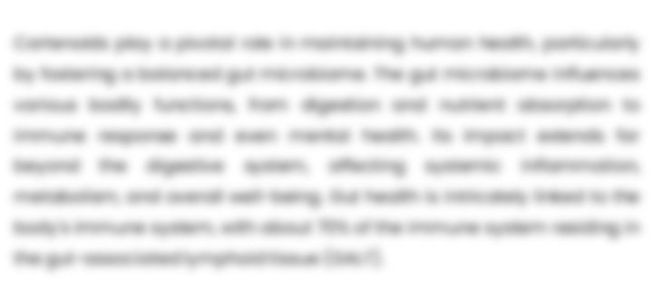
GLOBAL MARKET ANALYSIS – BY PRODUCT TYPE
GERMAN EXTRACT-BASED MAGISTRALS MARKET SIZE, BY PRODUCT TYPE, 2019-2032 (USD MILLION)
Key Takeaways
 | 2019 | 2020 | 2021 | 2022 | 2023 | 2024 | 2025 | 2026 | 2027 | 2028 | 2029 | 2030 | 2031 | 2032 | CAGR (2025–2032)
Herbal Extracts | XX | XX | XX | XX | XX | XX | XX | XX | XX | XX | XX | XX | XX | XX | XX%
Essential Oils | XX | XX | XX | XX | XX | XX | XX | XX | XX | XX | XX | XX | XX | XX | XX%
Phytochemicals | XX | XX | XX | XX | XX | XX | XX | XX | XX | XX | XX | XX | XX | XX | XX%
Spices | XX | XX | XX | XX | XX | XX | XX | XX | XX | XX | XX | XX | XX | XX | XX%
Others | XX | XX | XX | XX | XX | XX | XX | XX | XX | XX | XX | XX | XX | XX | XX%
Total | XX | XX | XX | XX | XX | XX | XX | XX | XX | XX | XX | XX | XX | XX | XX%
*Please note that this slide represents an indicative segmentation overview. the complete level-2 segmentation analysis will be covered in the Final Report.

Slide 26
GLOBAL MARKET ANALYSIS BY REGION
GERMAN EXTRACT-BASED MAGISTRALS MARKET-
HISTORIC YEAR 2019-2023 FORECAST TO 2032

Slide 27


GLOBAL MARKET ANALYSIS BY REGION
GERMAN EXTRACT-BASED MAGISTRALS MARKET: REGIONAL ANALYSIS, 2019-2032 (USD MILLION)
Key Takeaways
Europe
North America secured the foremost market share at 30.4%, and this dominance is projected to persist through the forecast period. This stronghold is attributed to the region's dense concentration of market competitors and an upsurge in cancer incidence rates. Notably, the U.S. witnessed approximately 1,806,590 new cancer diagnoses in 2020, as reported by the National Cancer Institute. The continuous integration of novel technologies, incorporating artificial intelligence, and the frequent launch of low-radiation CT scans are anticipated to further contribute to the region's market growth.
Conversely, Asia Pacific is poised for noteworthy growth, projected to experience a substantial Compound Annual Growth Rate (CAGR) over the forecast period. This surge can be attributed to the ongoing development of healthcare infrastructure, particularly in burgeoning economies such as India and China. The region's high adoption rate of advanced medical imaging devices, coupled with the increasing prevalence of chronic disorders, further fuels market expansion. Notably, local manufacturers in the region are gaining prominence, bolstering market growth.
North America
APAC
MEA
Latin America
Region | 2019 | 2020 | 2021 | 2022 | 2023 | 2024 | 2025 | 2026 | 2027 | 2028 | 2029 | 2030 | 2031 | 2032 | CAGR (2025-2032)
North America | XX | XX | XX | XX | XX | XX | XX | XX | XX | XX | XX | XX | XX | XX | XX%
Europe | XX | XX | XX | XX | XX | XX | XX | XX | XX | XX | XX | XX | XX | XX | XX%
Asia-Pacific | XX | XX | XX | XX | XX | XX | XX | XX | XX | XX | XX | XX | XX | XX | XX%
Latin America | XX | XX | XX | XX | XX | XX | XX | XX | XX | XX | XX | XX | XX | XX | XX%
Middle East & Africa | XX | XX | XX | XX | XX | XX | XX | XX | XX | XX | XX | XX | XX | XX | XX%
Total | XX | XX | XX | XX | XX | XX | XX | XX | XX | XX | XX | XX | XX | XX | XX%

Slide 28
NORTH AMERICA MARKET ANALYSIS – BY PRODUCT TYPE
NORTH AMERICA GERMAN EXTRACT-BASED MAGISTRALS MARKET SIZE, BY PRODUCT TYPE, 2019-2032 (USD MILLION)
 | 2019 | 2020 | 2021 | 2022 | 2023 | 2024 | 2025 | 2026 | 2027 | 2028 | 2029 | 2030 | 2031 | 2032 | CAGR (2025–2032)
Herbal Extracts | XX | XX | XX | XX | XX | XX | XX | XX | XX | XX | XX | XX | XX | XX | XX%
Essential Oils | XX | XX | XX | XX | XX | XX | XX | XX | XX | XX | XX | XX | XX | XX | XX%
Phytochemicals | XX | XX | XX | XX | XX | XX | XX | XX | XX | XX | XX | XX | XX | XX | XX%
Spices | XX | XX | XX | XX | XX | XX | XX | XX | XX | XX | XX | XX | XX | XX | XX%
Others | XX | XX | XX | XX | XX | XX | XX | XX | XX | XX | XX | XX | XX | XX | XX%
Total | XX | XX | XX | XX | XX | XX | XX | XX | XX | XX | XX | XX | XX | XX | XX%
Key Takeaways

Slide 29
U.S. MARKET ANALYSIS – BY PRODUCT TYPE
U.S. GERMAN EXTRACT-BASED MAGISTRALS MARKET SIZE, BY PRODUCT TYPE, 2019-2032 (USD MILLION)
 | 2019 | 2020 | 2021 | 2022 | 2023 | 2024 | 2025 | 2026 | 2027 | 2028 | 2029 | 2030 | 2031 | 2032 | CAGR (2025–2032)
Herbal Extracts | XX | XX | XX | XX | XX | XX | XX | XX | XX | XX | XX | XX | XX | XX | XX%
Essential Oils | XX | XX | XX | XX | XX | XX | XX | XX | XX | XX | XX | XX | XX | XX | XX%
Phytochemicals | XX | XX | XX | XX | XX | XX | XX | XX | XX | XX | XX | XX | XX | XX | XX%
Spices | XX | XX | XX | XX | XX | XX | XX | XX | XX | XX | XX | XX | XX | XX | XX%
Others | XX | XX | XX | XX | XX | XX | XX | XX | XX | XX | XX | XX | XX | XX | XX%
Total | XX | XX | XX | XX | XX | XX | XX | XX | XX | XX | XX | XX | XX | XX | XX%
Key Takeaways

Slide 30
COMPETITIVE LANDSCAPE Competitive Dashboard Market Positioning of Key Players, 2024 Strategies Adopted By Key Market Players Recent Development Market Share Analysis, 2024
GERMAN EXTRACT-BASED MAGISTRALS MARKET -
HISTORIC YEAR 2019-2023 FORECAST TO 2032

Slide 31




COMPETITIVE LANDSCAPE
The following figure represents the market positioning of German Extract-Based Magistrals Market players for the year 2024. The market positioning of the leading player is done considering the following points:

Slide 32
COMPETITIVE DASHBOARD
COMPETITORS | ANKLAM EXTRAKT GMBH | Company 2 | Company 3 | Company 4 | Company5
Headquarters | Germany | - | - | - | -
No of Employees(2024) | 80 | - | - | - | -
Revenue (US$) 2024 | Not disclosed | - | - | - | -
Industry Type | - | - | - | - | -
Geographic Presence | Global | - | - | - | -
Year of Establishment | 2007 | - | - | - | -
Market Position | - | - | - | - | -

Slide 33
COMPANY PROFILES
GERMAN EXTRACT-BASED MAGISTRALS MARKET -
HISTORIC YEAR 2019-2023 FORECAST TO 2032

Slide 34
ANKLAM EXTRAKT GMBH - COMPANY OVERVIEW
COMPANY AT A GLANCE
OVERVIEW
Established | 2007
Headquarter | Germany
Ownership | Private
Revenue (US$)- 2024 | Not disclosed
No. of Employees (2024) | 80
Website | anklam-extrakt.de
Anklam Extrakt GmbH develops and manufactures botanical extracts for pharmaceutical, food supplement and food applications, supplying HMPC/Ph. Eur. monographed materials used in Germany’s magistral preparations. The company offers liquid, soft and dry extracts and contract development from raw material to dossier support. It markets branded ingredients such as Delphinol and MaquiBright, with scientific substantiation to aid customer claims. Recent initiatives include expanding distribution via partnerships and strengthening IP around bone-health actives. Operations follow GMP, ISO 22000, HACCP and kosher/organic regimes. Strategic priorities center on quality, regulatory readiness, and tailored solutions for B2B customers across global markets.
PRODUCT/SERVICE PORTFOLIO
PRODUCT/SERVICE NAME | PRODUCT/SERVICE DESCRIPTION
Standardized ivy leaf dry extract manufactured under GMP and suitable for German magistral preparations and OTC cough formulations. Offered in pharmacopeial-compliant grades with defined saponin content and supported by full analytical documentation. Available with technical support for formulation, stability, and regulatory dossiers to meet HMPC/Ph. Eur. expectations.
Hedera helix (ivy leaf) dry extract

Slide 35
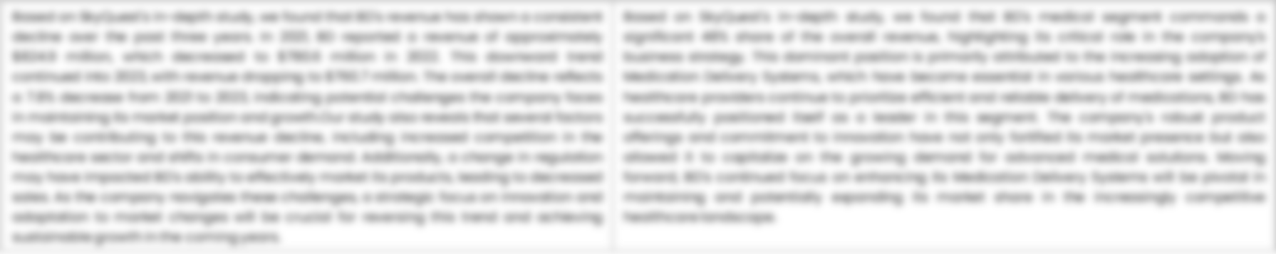
ANKLAM EXTRAKT GMBH - FINANCIAL OVERVIEW
ANKLAM EXTRAKT GMBH - RECENT FINANCIALS IN USD BILLION (2022-2024) | ANKLAM EXTRAKT GMBH - BUSINESS REVENUE MIX, 2024 IN PERCENTAGE (%)
SKYQUEST'S TAKE ON THE COMPANY

Slide 36

ANKLAM EXTRAKT GMBH – KEY DEVELOPMENTS
DATE | TYPE OF DEVELOPMENT | DESCRIPTION
October 2023 | Partnership | Microsoft and Siemens are deepening their partnership by bringing the benefits of generative AI to industries worldwide. As a first step, the companies are introducing Siemens Industrial Copilot, an AI-powered jointly developed assistant aimed at improving human-machine collaboration in manufacturing. In addition, the launch of the integration between Siemens Teamcenter software for product lifecycle management and Microsoft Teams will further pave the way to enabling the industrial metaverse.
May 2023 | Product launch | Microsoft Corp. announced a suite of new AI solutions and improvements to Microsoft Clumping Clay for Nonprofit that are designed to transform the nonprofit industry and how fundraisers engage with donors, manage campaigns and optimize operations. In addition, the company announced a limited private preview for nonprofits to experience a new AI-powered fundraising propensity model.

Slide 37
ABOUT US & APPENDIX

Slide 38




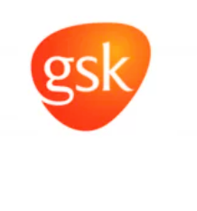






ABOUT US
Established in 2006, SkyQuest is a Global Market Intelligence, Innovation Management organization that connects innovation to new markets, networks & collaborators for achieving sustainable development goals.
SOME OF OUR CLIENTS
180+ Institutional Clients 125000+ Streaming Clients 500+ Workshops Organized
Sectoral Coverage
| Information Technology | Clean Tech | Marketing & Advertising | Water | Life Sciences and Social | Social | Energy and Power | Food & Beverage | Training & E-Learnings & Materials | Semiconductor & Electronics | Oil & Gas | Banking, Financial, Capital Markets, Insurance

Slide 39
OUR CUSTOMIZED RESEARCH CAPABILITIES
CUSTOMER, DISTRIBUTOR, SUPPLIER INTELLIGENCE
TYPE INTELLIGENCE SUPPORT
Identification of potential partners
Shortlisting/finalization of potential partners
Customer need analysis
Customer's purchase and usage behavior
Customer/partner feedback and satisfaction
Brand perception analysis
Import and Export Intelligence
Commodity pricing intelligence
Product pricing intelligence
Product Positioning Assessment
New product launch tracker
Product claims assessment
Product Concept Testing
COMPETITIVE DASHBOARD SUPPORT
MARKET INTELLIGENCE SUPPORT
Company profiling
Competition assessment incl. market share
Drilled down revenue estimations
Employer value proposition
Market size and segmentation
Growth opportunities
Market dynamics and new developments
Go to Market Strategies
DATA COLLECTION AND ANALYSIS SUPPORT
MARKET STRUCTURE ASSESSMENT
Data analytics and visualization
Data collection, manipulation incl. web scraping
B2B and B2C surveys and interviews
Macroeconomic analysis
Value Chain and Communication Analysis
Regulatory assessment
Coating layer scouting and assessment

Slide 40
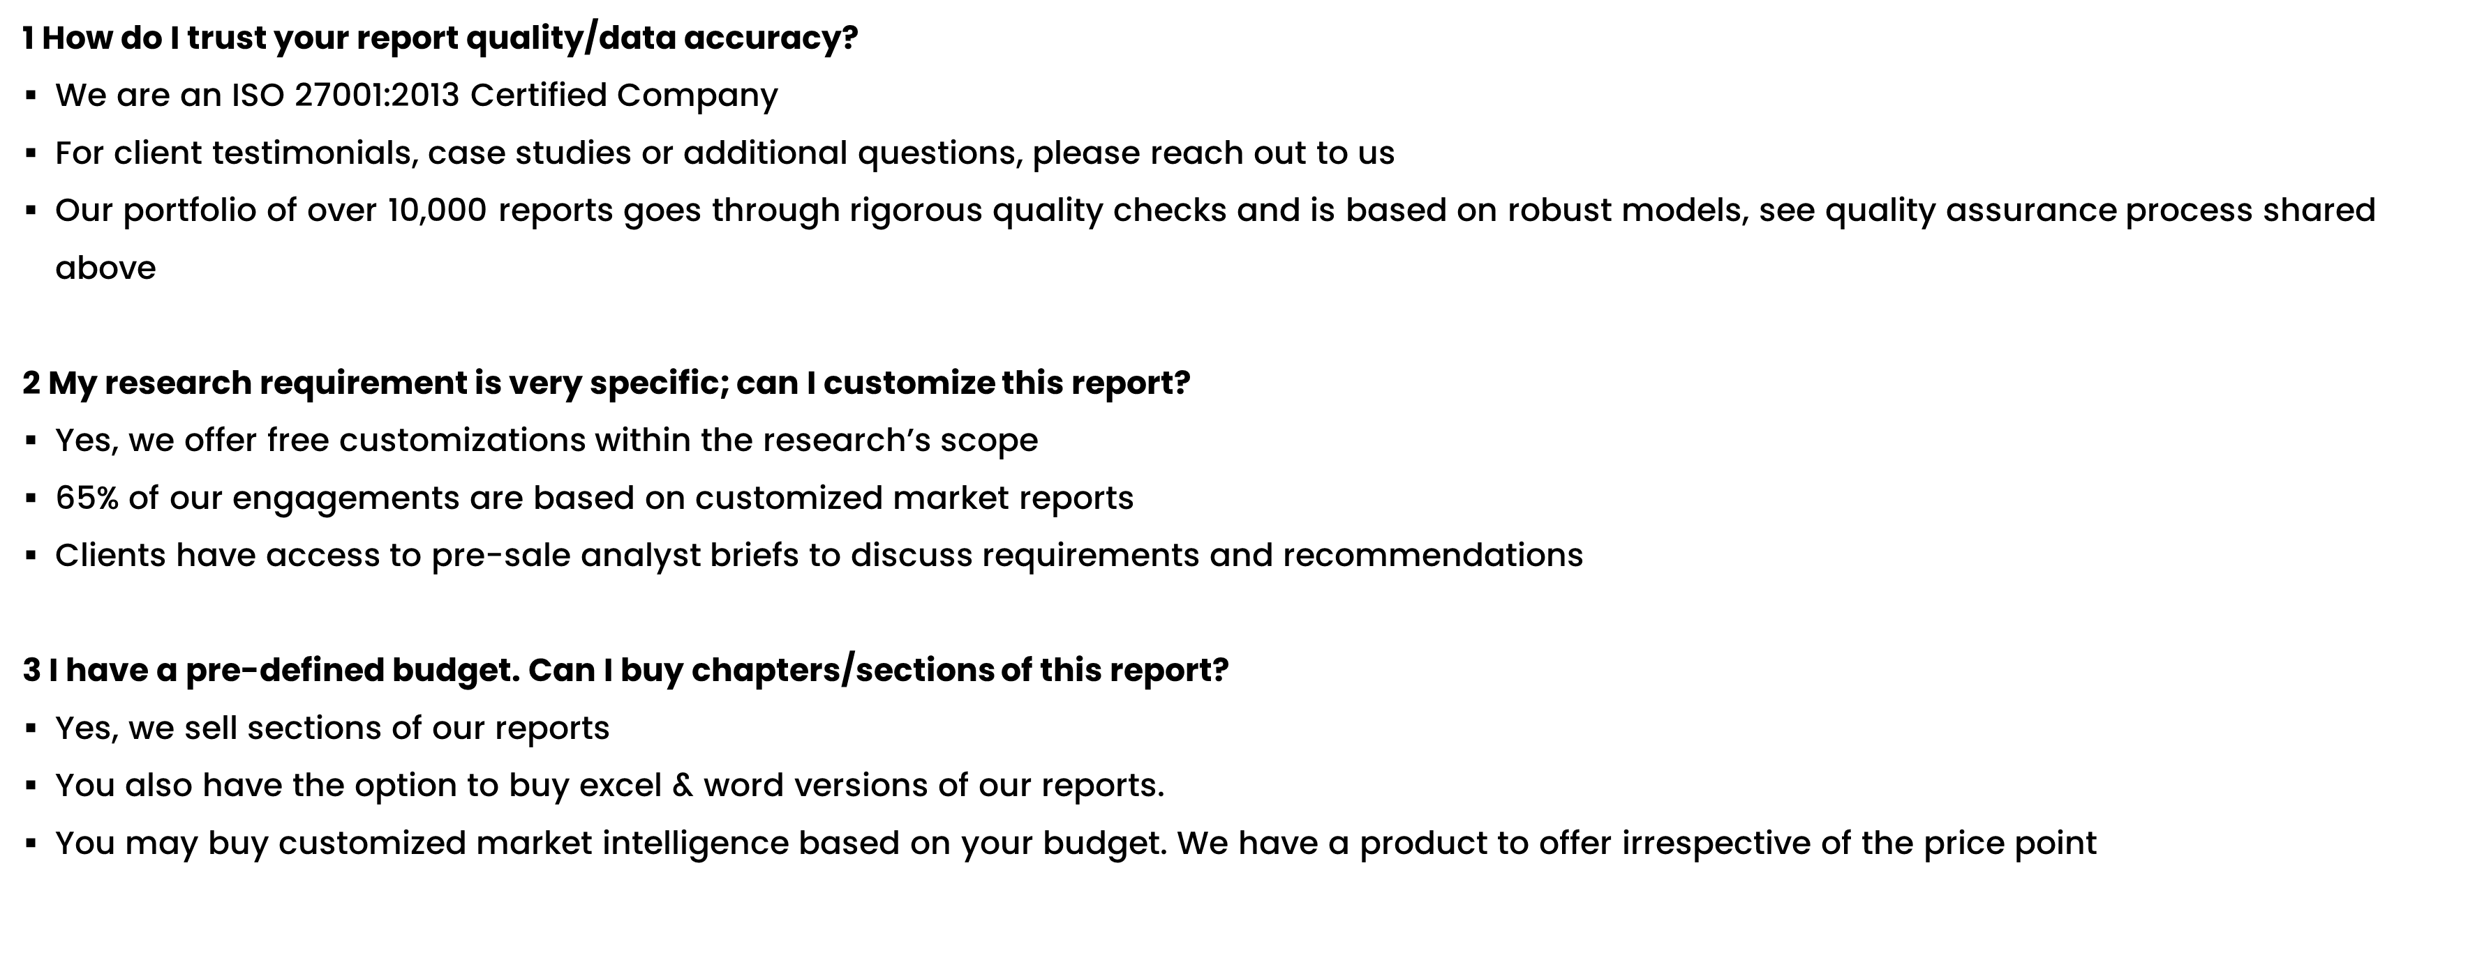
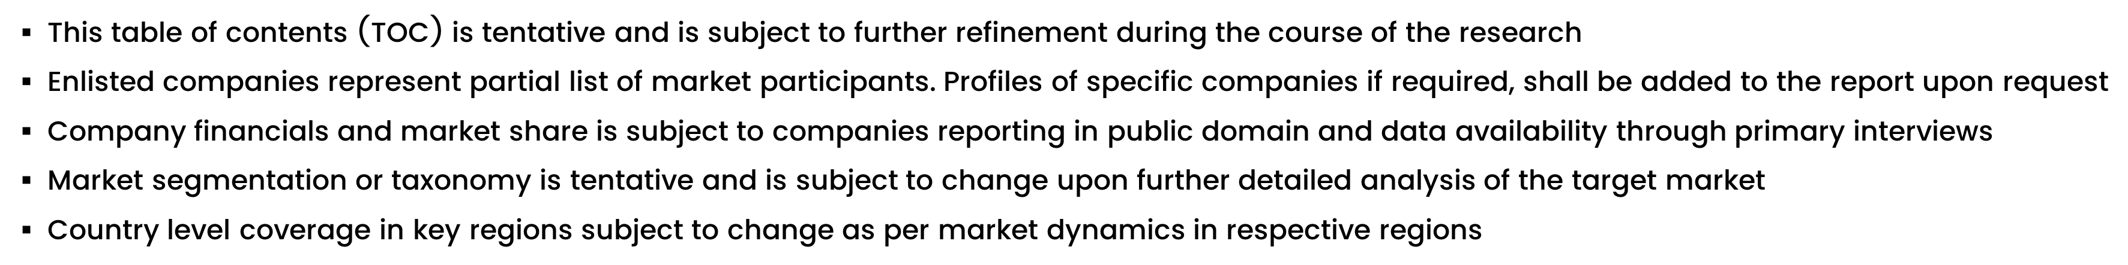
FAQs
NOTE

Slide 41






DISCLAIMER
SkyQuest provides strategic analysis to a select group of customers in response to orders. Our customers acknowledge when ordering that these strategic analysis for internal use and not for general publication or disclosure to any third party. SkyQuest does not endorse any vendor, product, or product type profiled in its publications. SkyQuest's strategic analysis constitutes estimations and projections based on secondary and primary research and are therefore subject to variations.
SkyQuest disclaims all warranties, expressed or implied, with respect to this research, including any warranties of merchantability or fitness, for any particular purpose. SkyQuest takes no responsibility for incorrect information supplied to it by manufacturers or users.
Trademarks, copyrights, and other forms of intellectual property belong to SkyQuest's respective owners and are protected by law. under no circumstance may any of these be reproduced, copied, or circulated in any form, without the prior written approval of SkyQuest's owner-as the case may be no part of this strategic analysis may be given, lent, resold, or disclosed to any third party, without express permission from SkyQuest team.
Reproduction and/or transmission in any form and by any means, including photocopying, mechanical, electronic, recording, or otherwise, without the permission of SkyQuest, is prohibited.
HEADQUARTERS
1 Apache Way, Westford, Massachusetts 01886, United States
APAC OFFICE
Room A & B, 2nd Floor, Lee Kee Commercial Building, 221-227, Queen’s Road Central, Hong Kong
GLOBAL DELIVERY CENTER
D-1001-1005, Swati Clover, Shilaj Circle, Sardar Patel Ring Rd, Thaltej, Ahmedabad, Gujrat-380054
WE ARE REACHABLE AT :-
info@skyquestt.com
+1-617-230-0741
www.skyquestt.com

Slide 42
THANK YOU
www.skyquestt.com

